Slide 1

A graph data model to study and manage sustainability data.

Slide 2
JUDGING CRITERIA - Hackathon
Impactfulness: Using better valid and relevant information is an advantage over decision making with limited information or low quality information. Democratization of skills and tools requires also access to relevant information. In order to overcome the limitations of today‘s data management principles we want to contribute to a new graph based approach for modeling the intent and the purpose of data in such a way, that context sensitive data flows can be automated based on expected outcome.
Innovativeness Besides the concept of publicly managed graph data assets we also contribute to a global data asset inventory which allows all of us to learn what data is used for which purpose. Furthermore we can start to track data coverage and improve data availability together with data quality.
Ambitiousness Our goal is to cover the full OpenStreetmap data and all Wikipedia data in one place. In addition, regional data assets will be blended in. This is a scale which currently can only be handled by the biggest software companies. But our global reseach community must be able to use such information for future research which includes contextual analysis and analysis of humen decision making and behavioural analysis in real world szenarios.
Applicability The demo we provide is a working example of the concept. Using a unified graph data model and a graph based metadata model is both possible in any industry given current infrastructure and available cloud servicces.

Slide 3
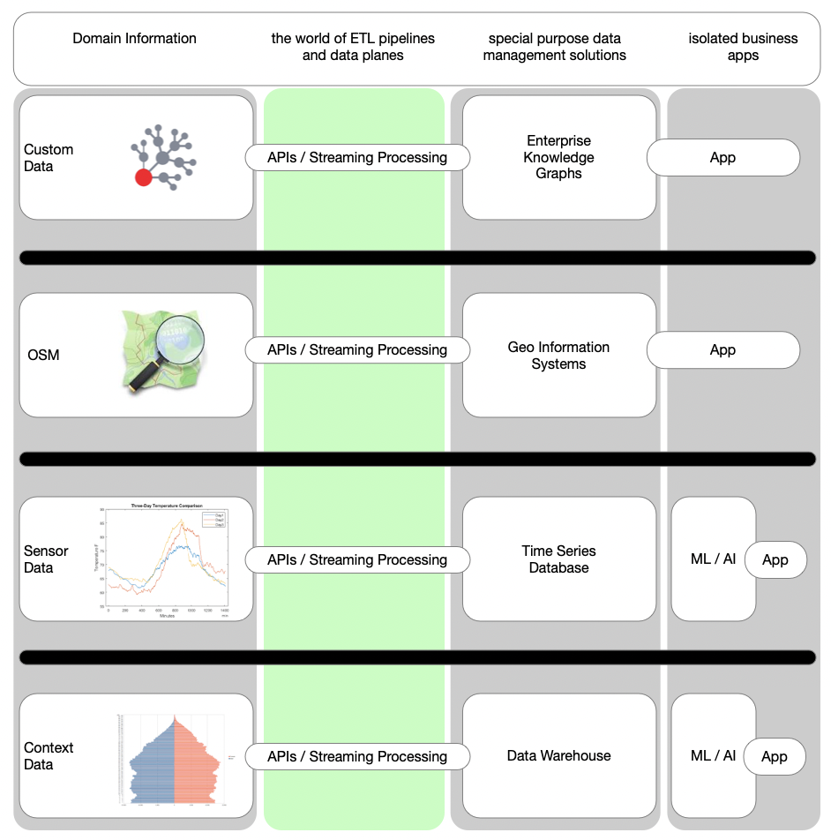
Isolation of data assets
Many public data assets are isolated
Integration of such public data is not easy, even with todays modern data platforms and cloud bases solutions.
One important goal is to overcome the barriers between the application domains.

Slide 4
What are our goals?
Identify, qualify & integrate data to track and measure sustainability and human impact.
1
Highlight missing data coverage to manage analysis bias. Improve data coverage over time in a systematic approach.
2
Illustrate the positive impact of human actions. Support day to day work by simplifying future dataproducts.
3

Slide 5
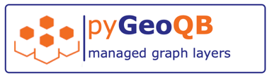
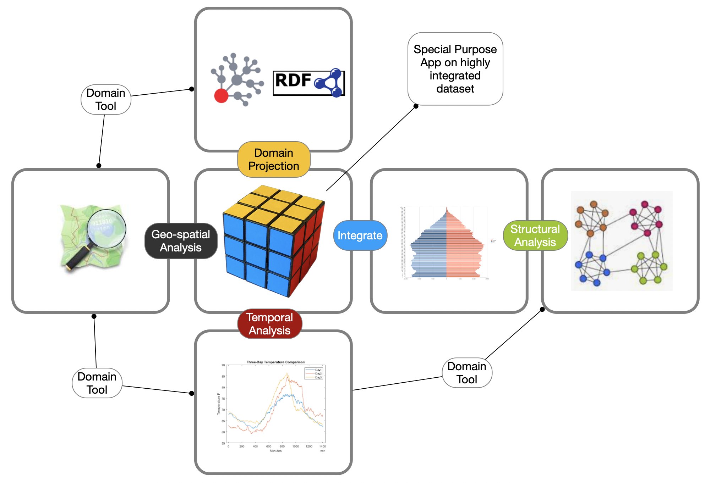

Slide 6
Core Concepts:
Data assets are organized in layers, like in a map.
Individual aspects of a problem can be combined in a layer.
Layers are stackable, each layer has its own meaning or context.
Relevance of layers is defined by weights and impact functions.
Each individual impact profile can lead to specific results.
GeoQB allows personalization and contextualization of data.
This leads to customized information and personalized maps.

Slide 7
Contextualization
Geo-Data:
data is typically provided with lat, lon coordinates (WGS 84)
we use geo-indexing to merge data from multiple domains on custom resolutions
Time Domain
time dependent observations have time stamps
series of observations are managed as episodes with time based indexing

Slide 8
GeoQB Layers
Data layers are defined by queries and semantic data mappings.

Slide 9
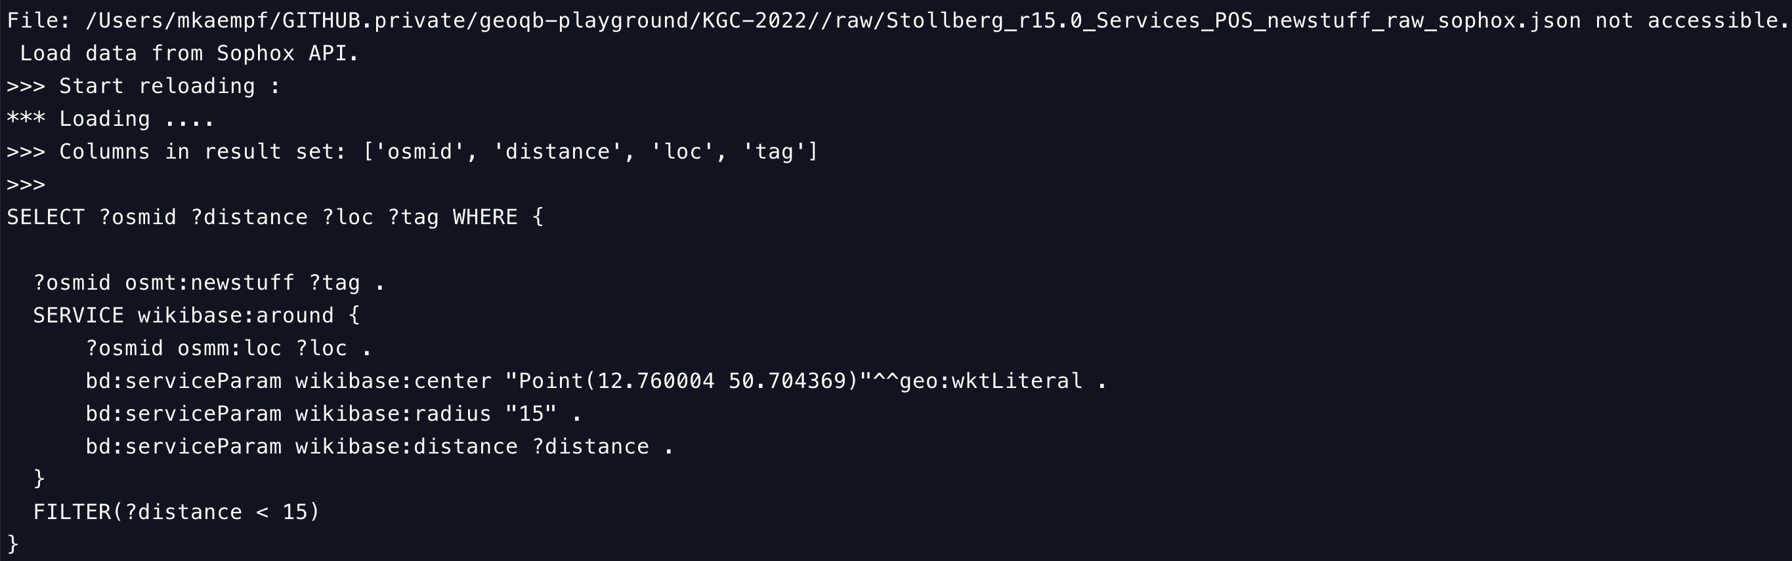
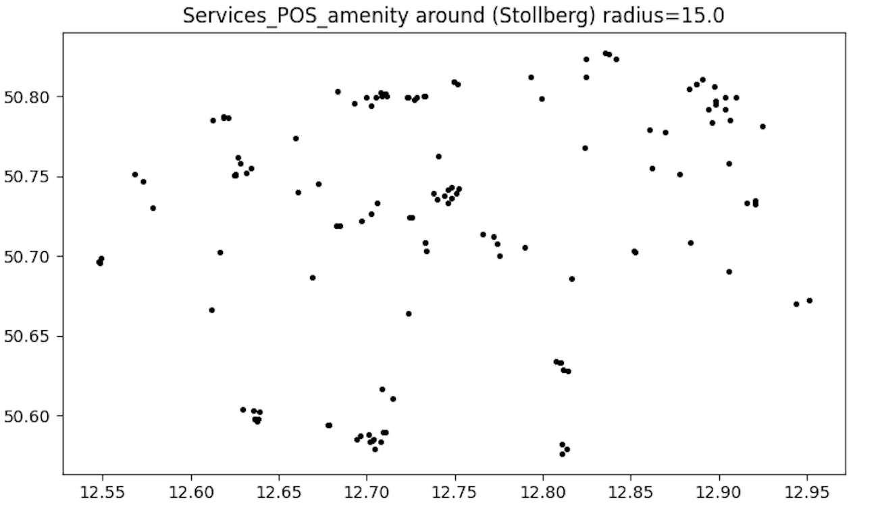
GeoQB Layer
Defined by a SPARQL query.
Buffered in local workspace ➔ ingested into graph data model.

Slide 10
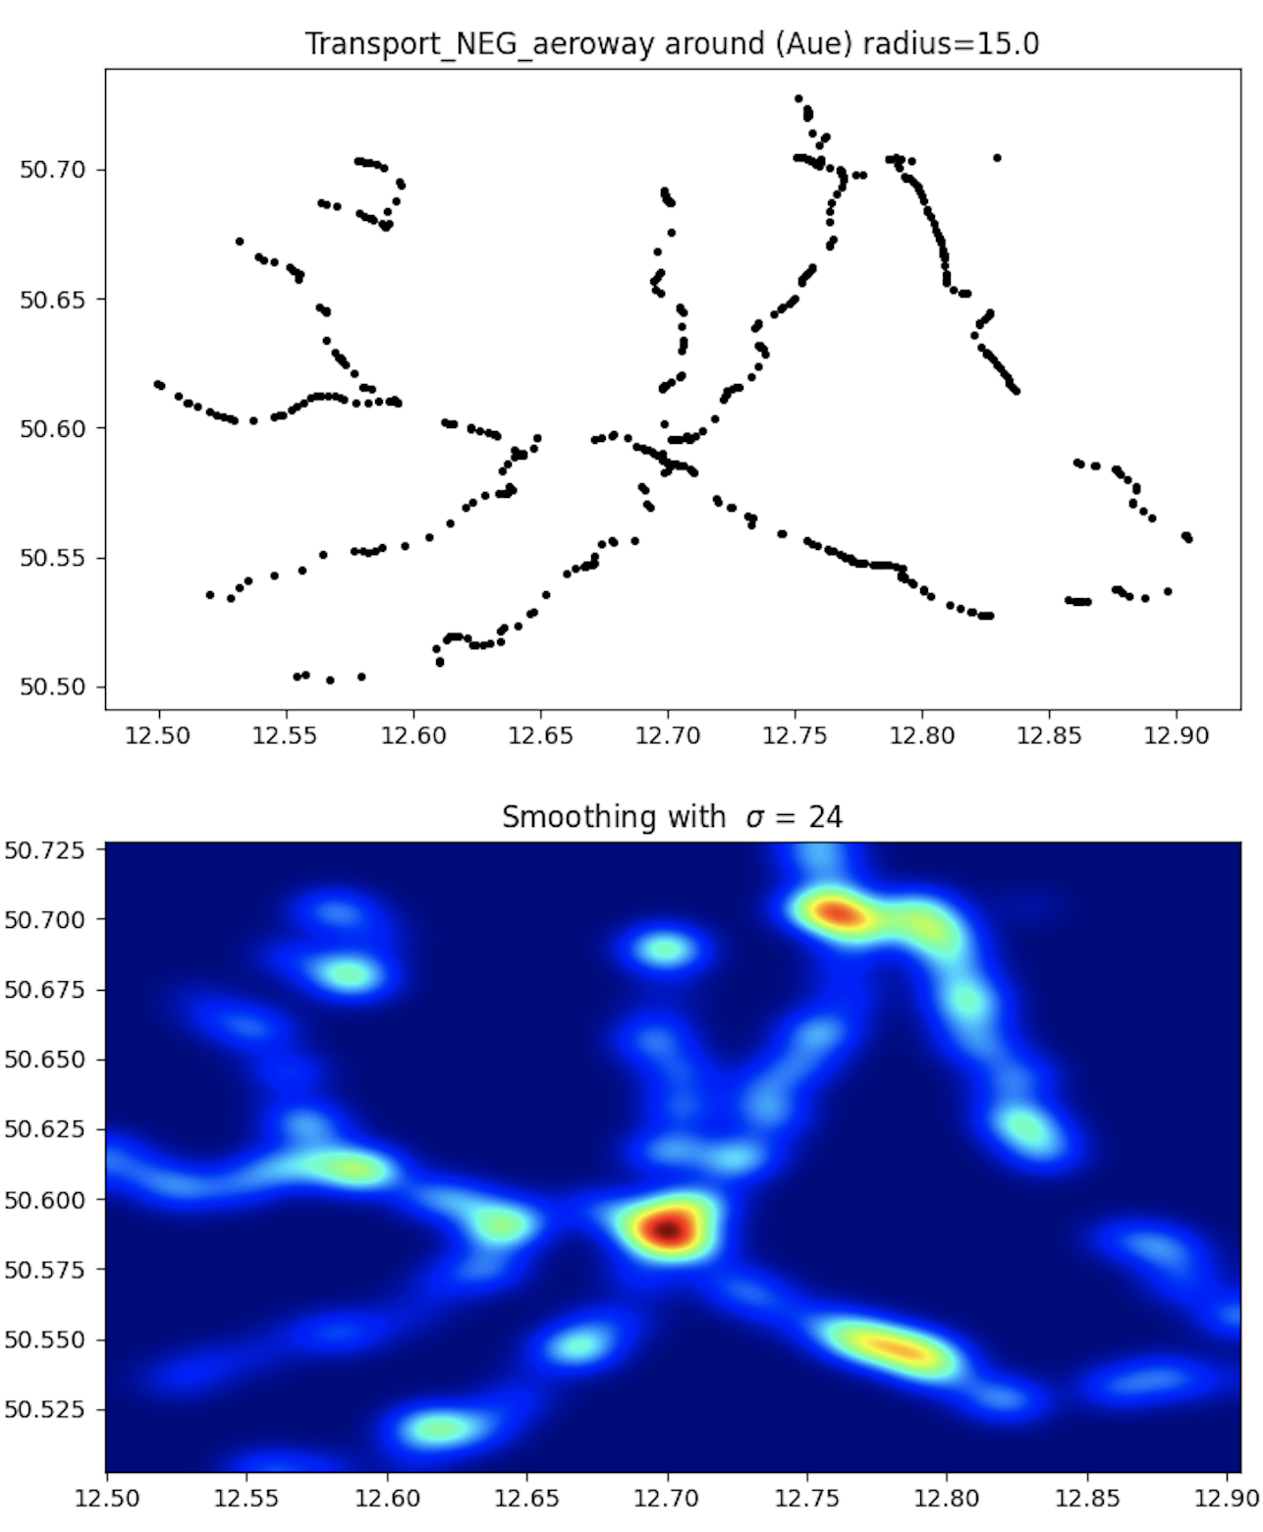
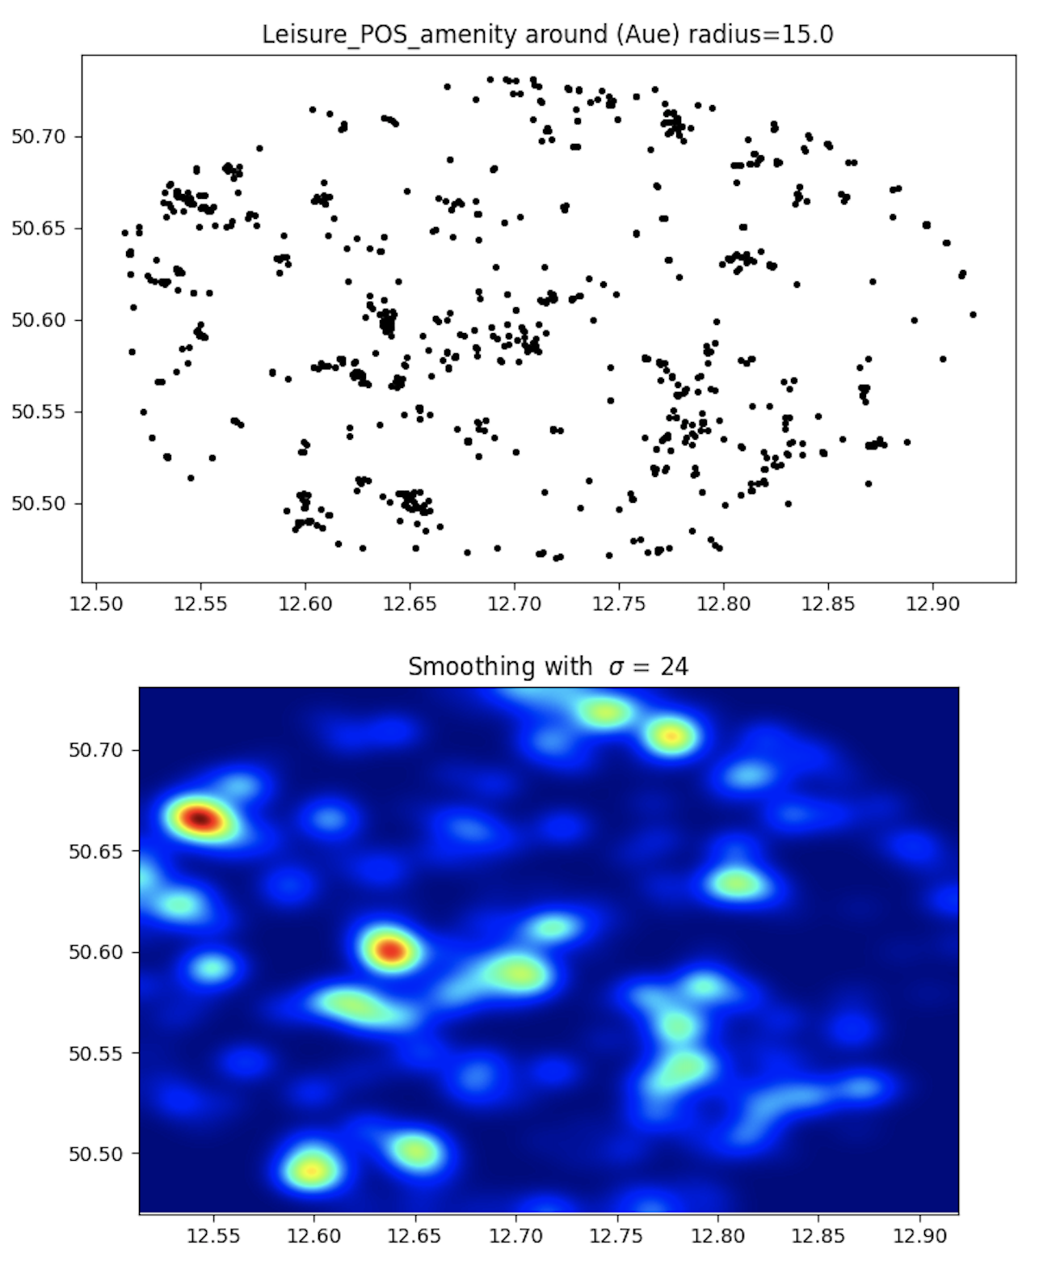

Slide 11
Layer Analysis
Node2Vec based clustering

Slide 12
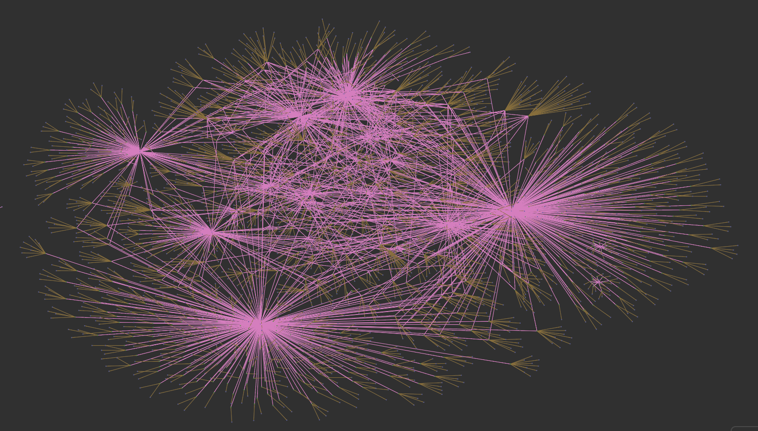
All layers … the backbone of the data model

Slide 13
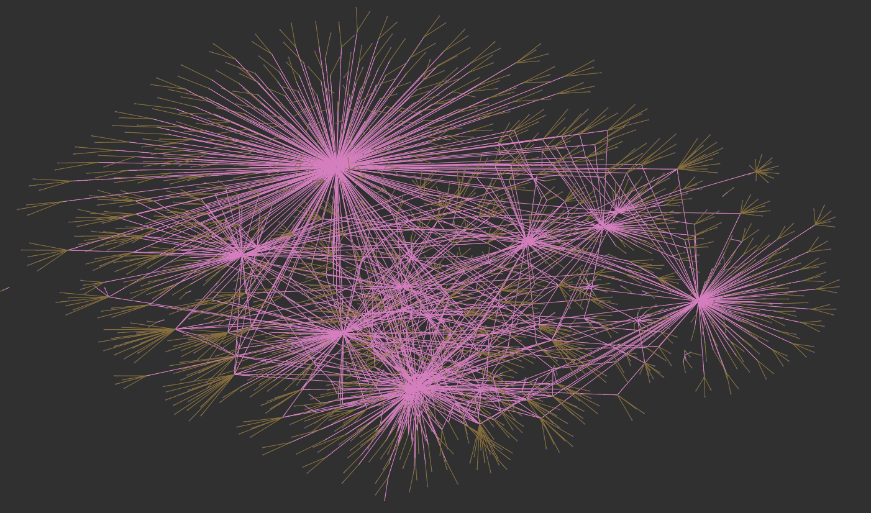
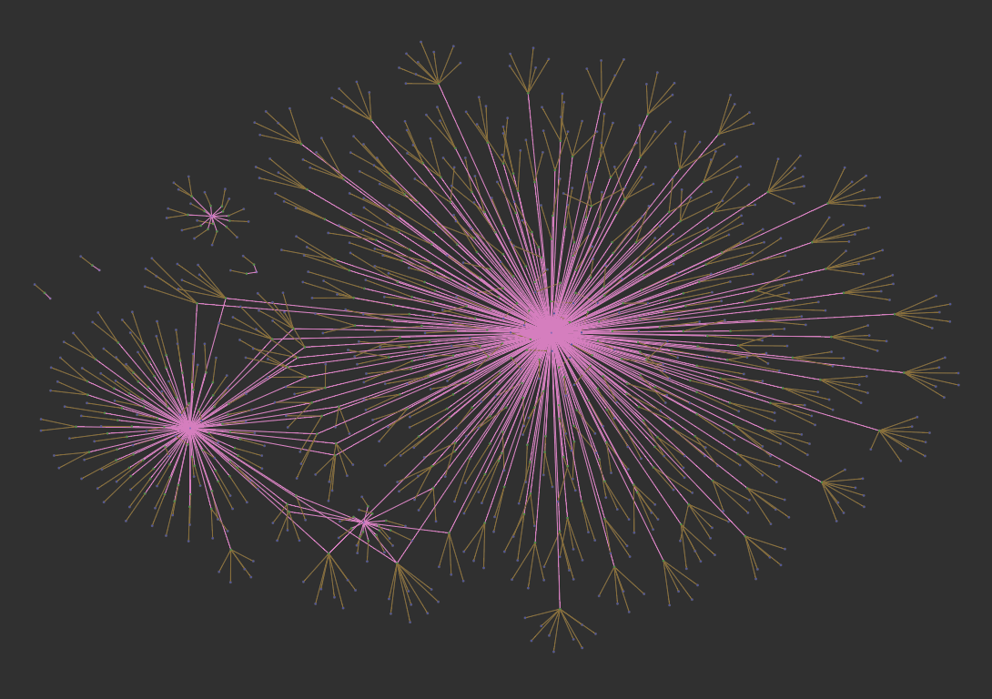
Positive ➔
⬅ Negative

Slide 14
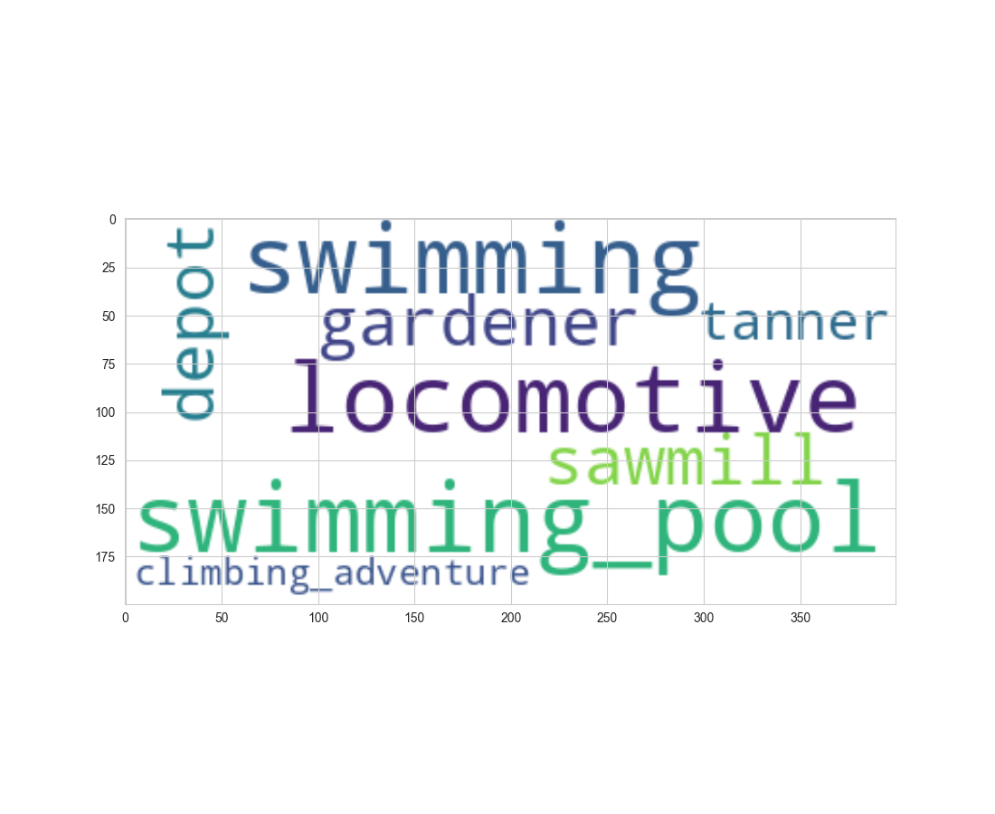
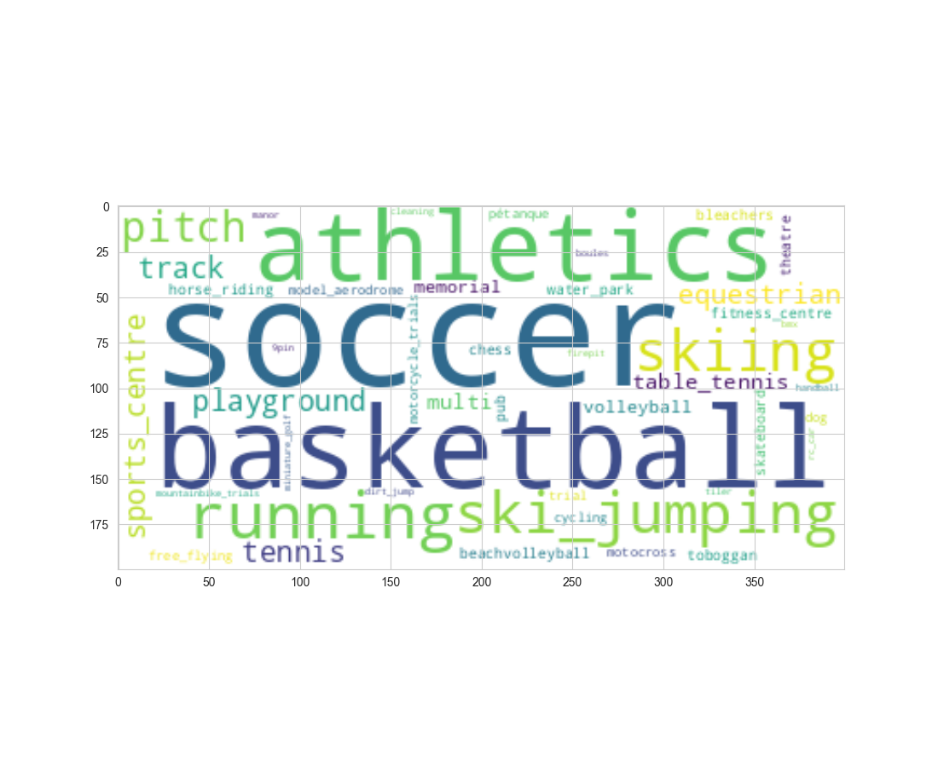
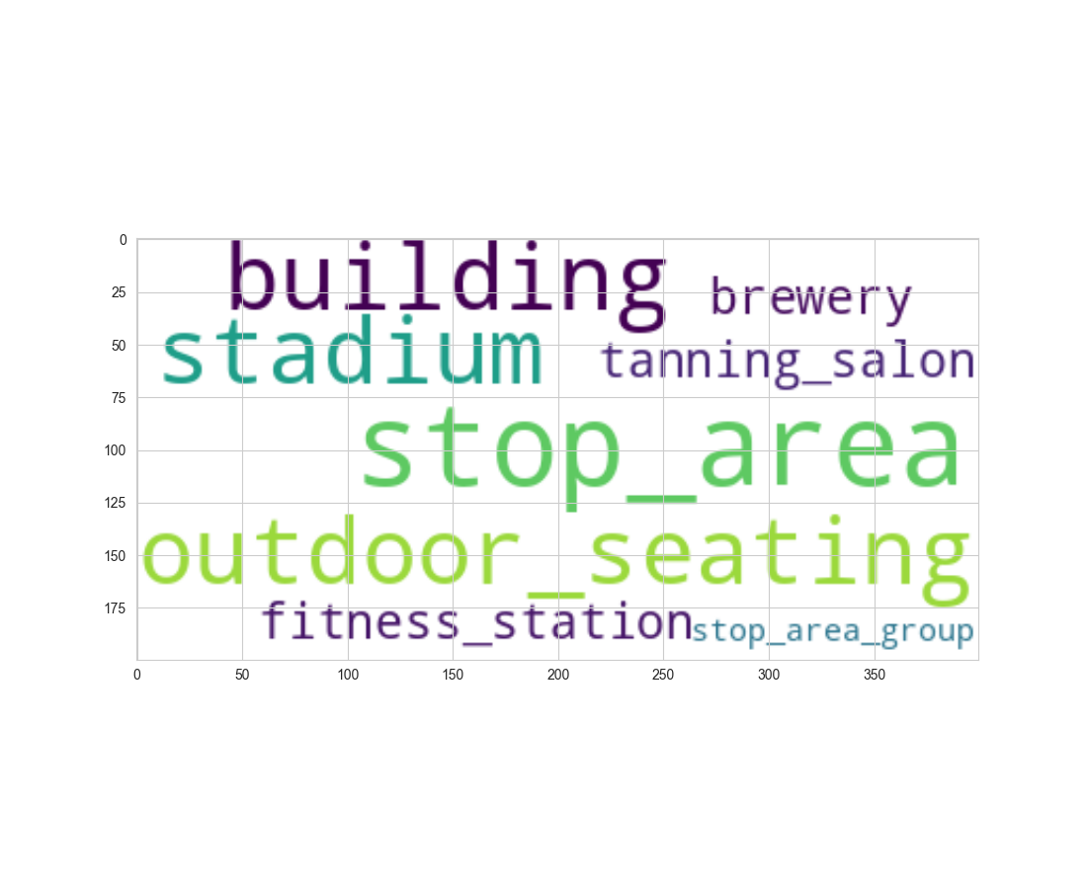
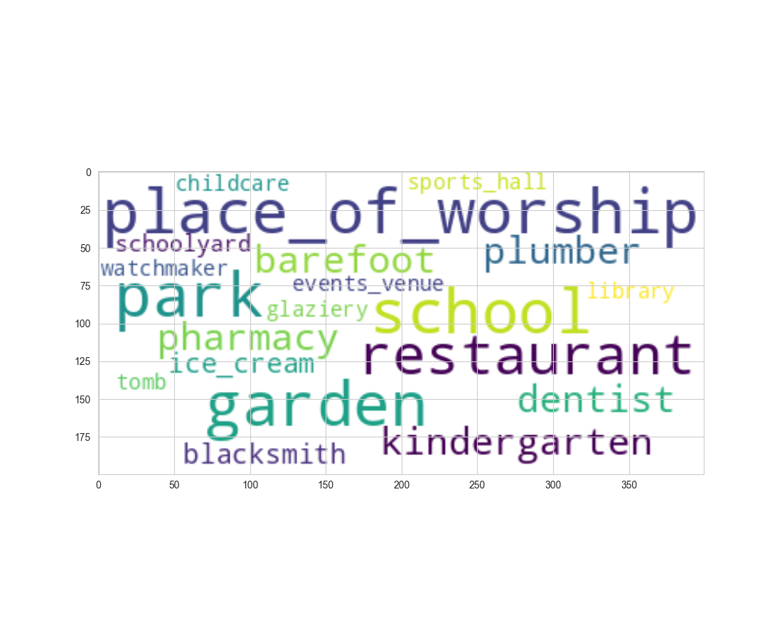
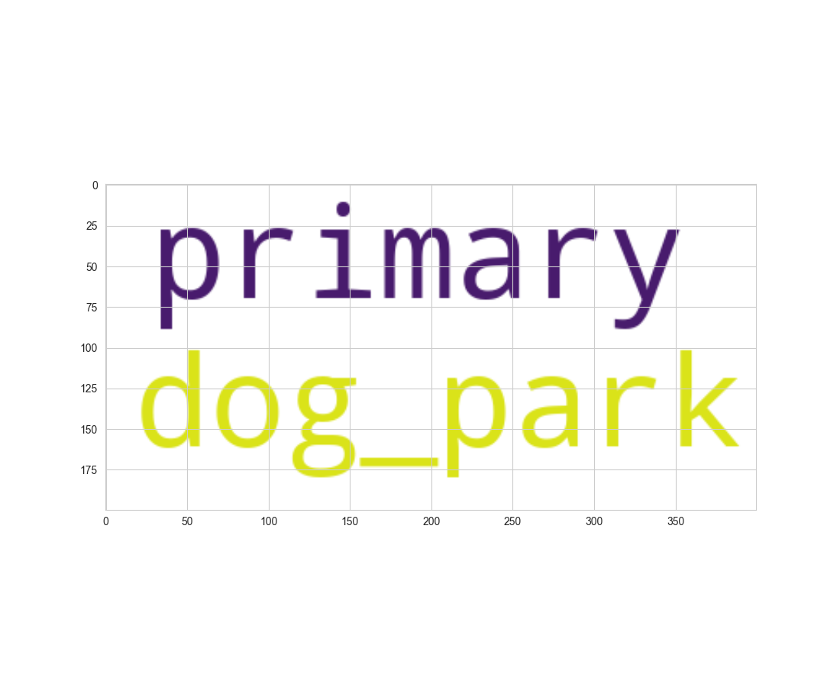
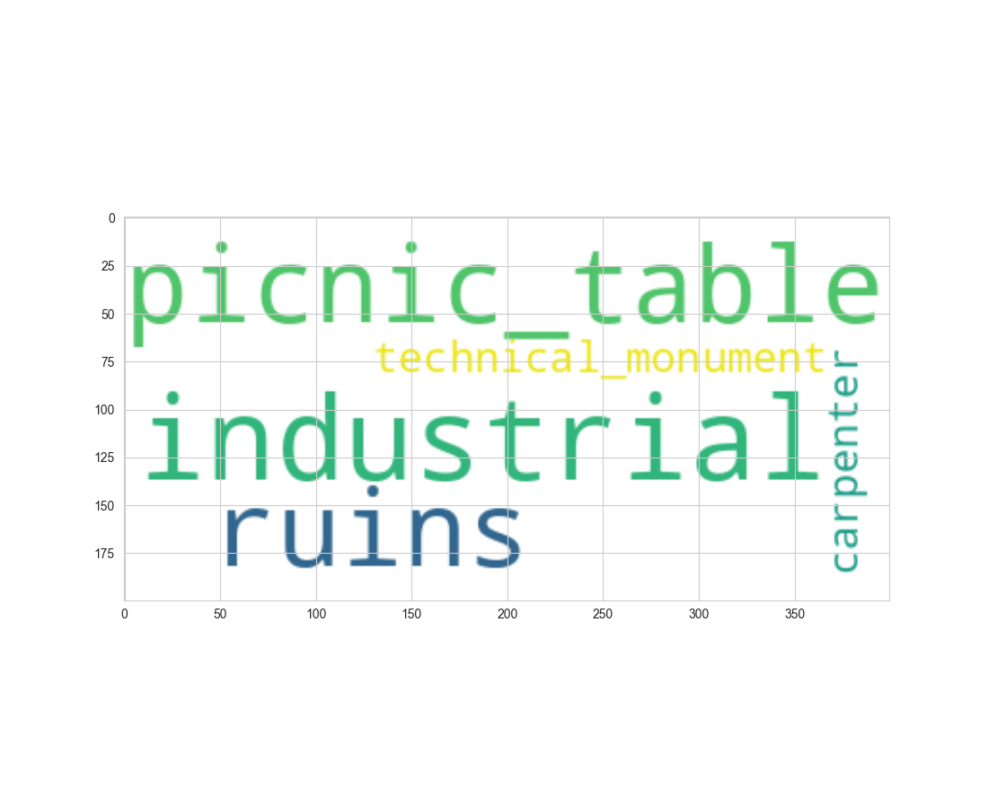
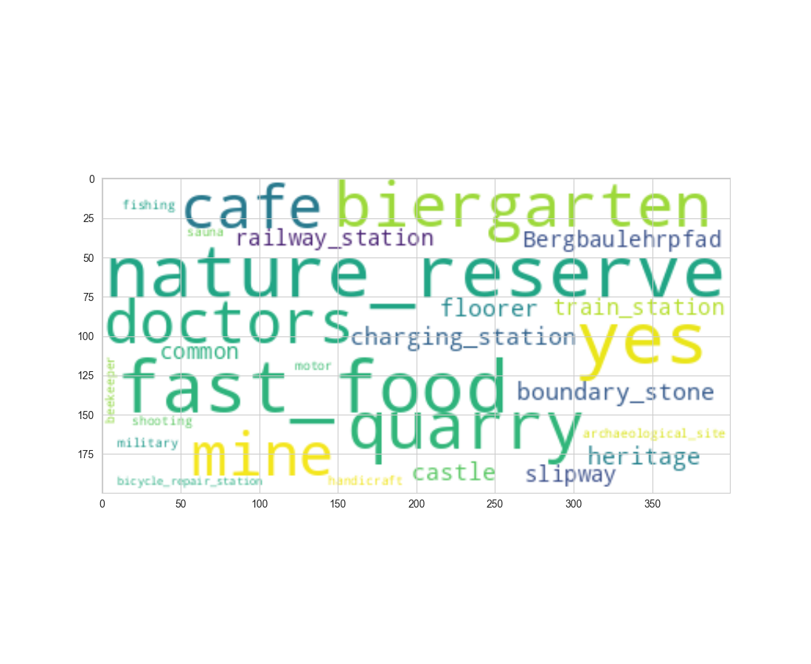
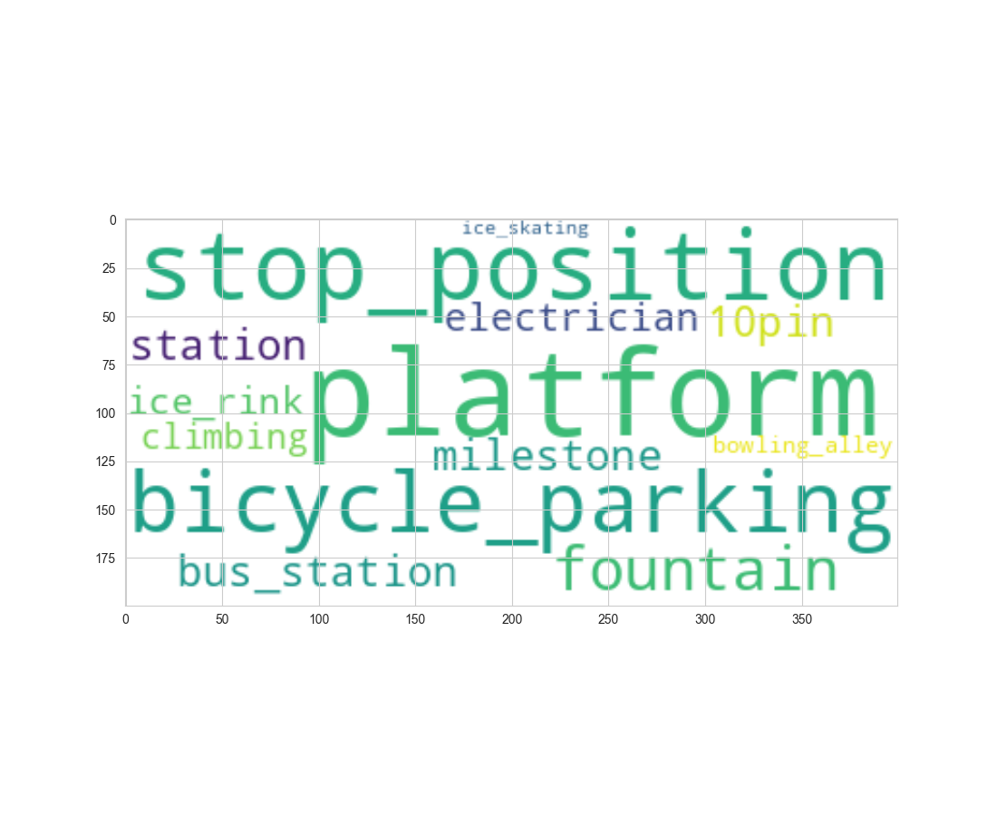

Slide 15
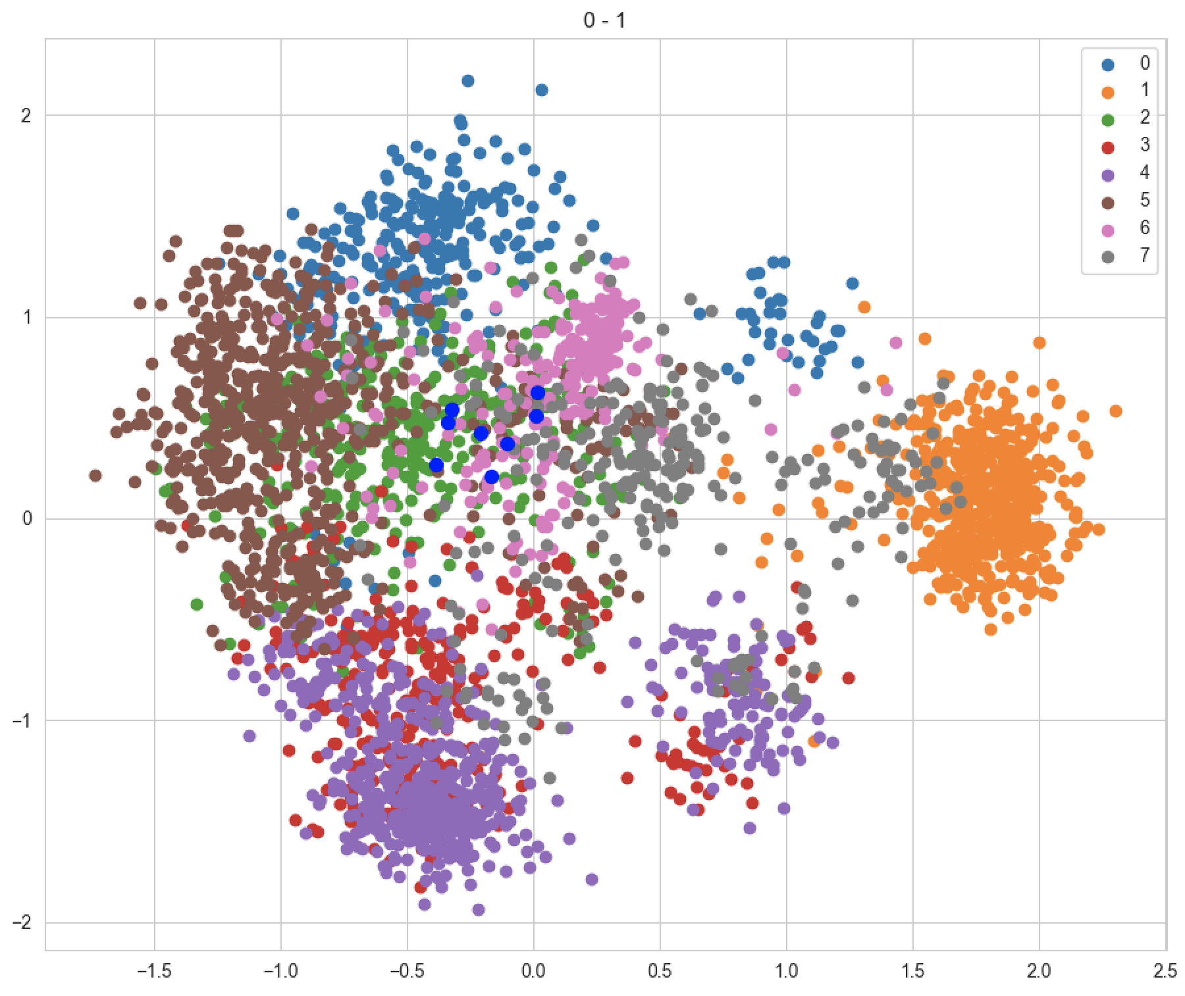

Slide 16
GeoQB Assets

Slide 17
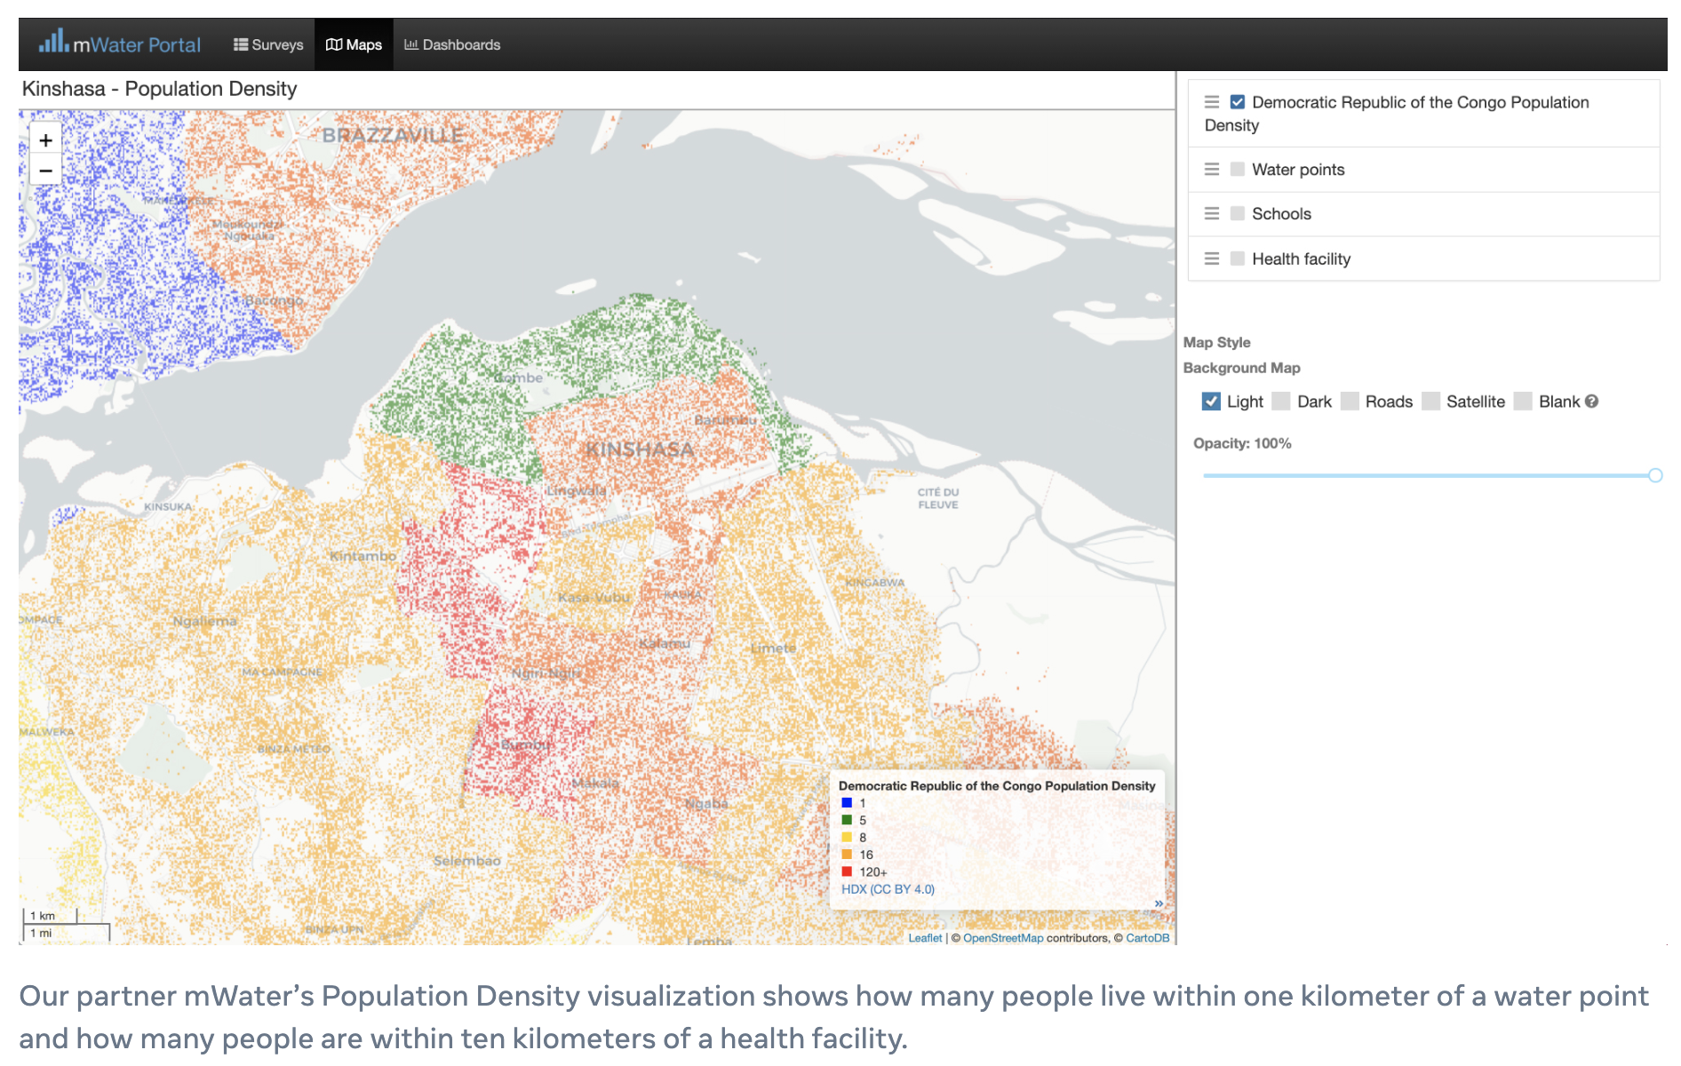
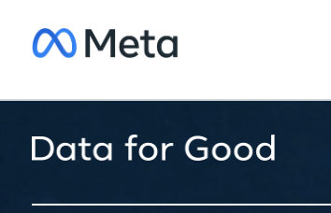

Slide 18
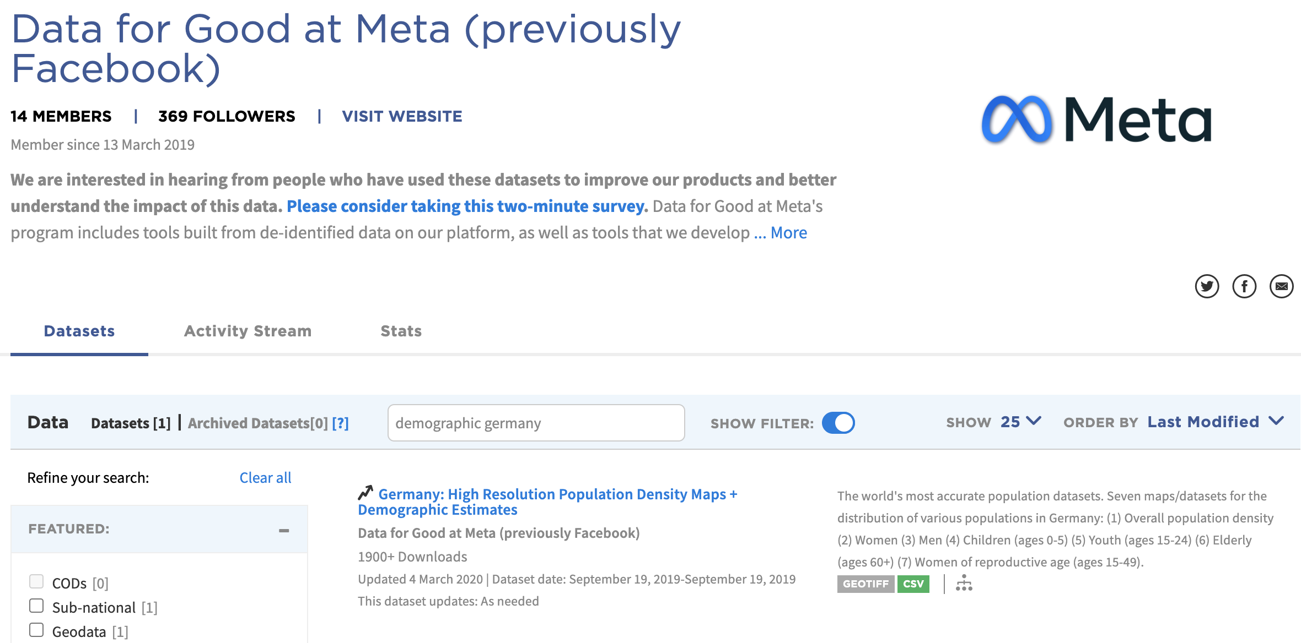

Slide 19
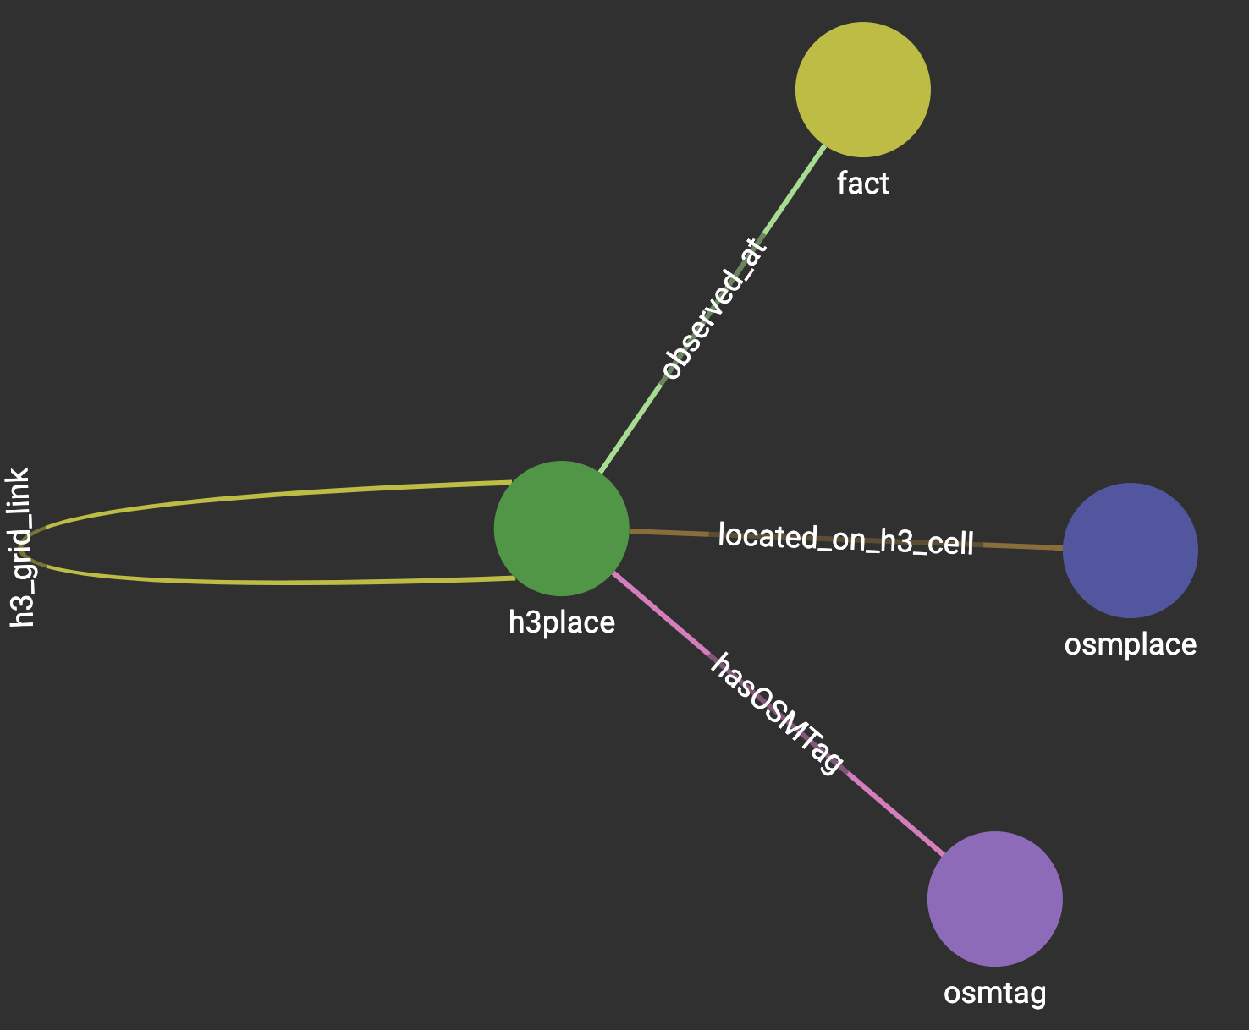
Data Blending …
Observations are added as links bet-ween the place of the observation and an observation-type node. Time and values are modeled as edge properties.

Slide 20
GeoQB Workspace

Slide 21
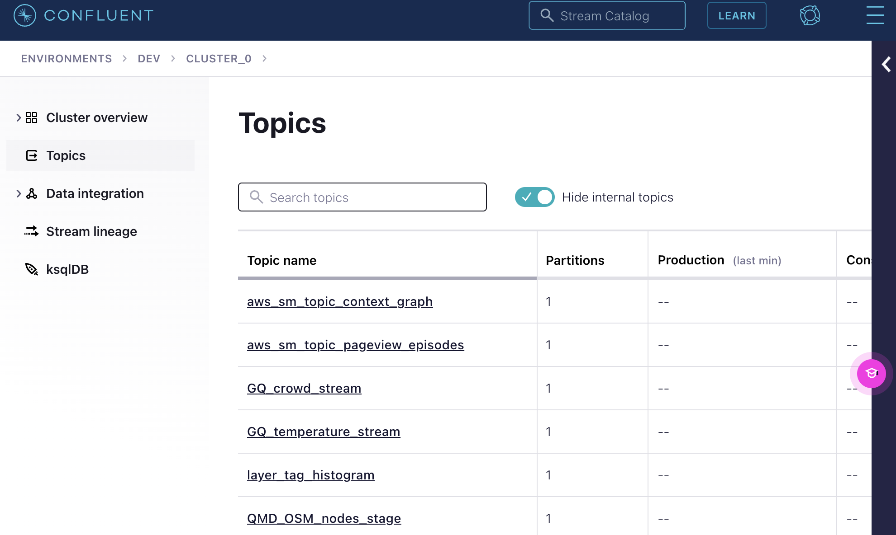
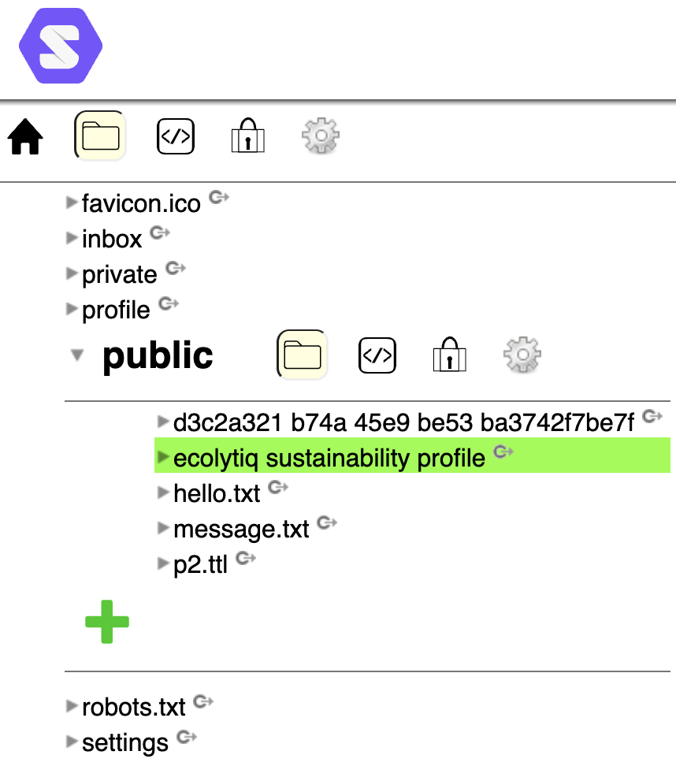
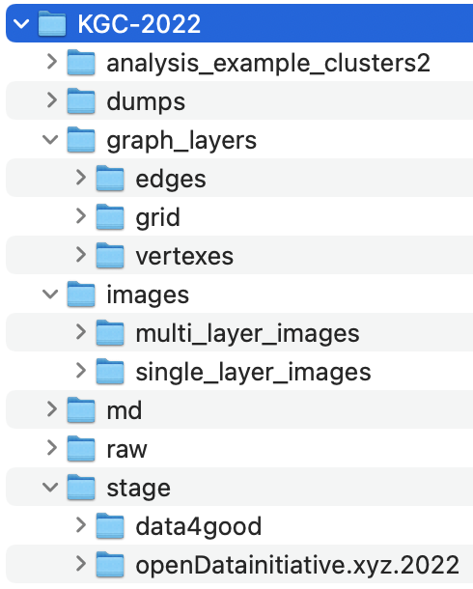
Files + Data Streams + Shared Assets

Slide 22
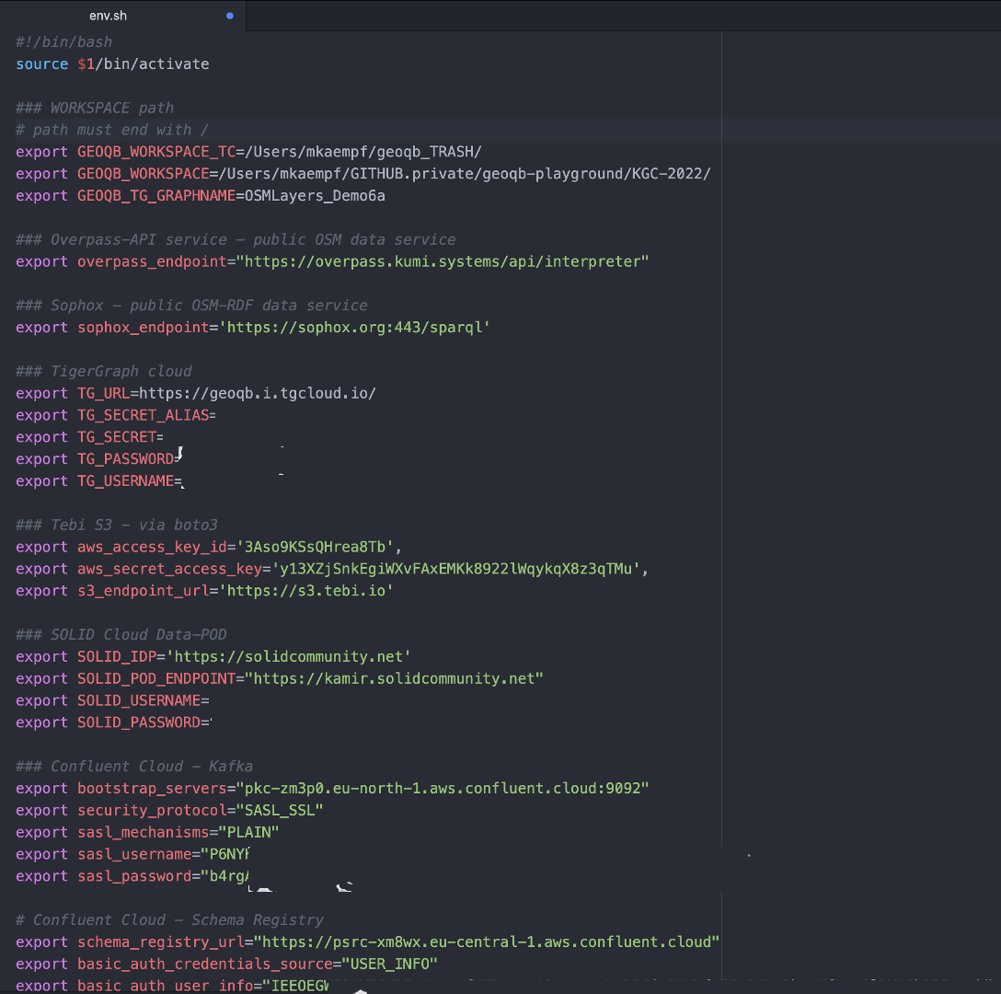
Technical Integration
configure access to remote data assets via ENV variables
use existing client integrations to read data from SPARQL endpoints, REST APIs, or even Apache Kafka topics.

Slide 23
Using the CLI

Slide 24
